Slide 1

Academic Session 2025-26
Even Semester Jan-May 2025
UNIVERSITY INSTITUTE OF ENGINEERING
AIT-CSE (AIML)
CS221: B.E. CSE (AIML)
5th Semester
ADVANCED MACHINE LEARNING & MATHEMATICAL MODELLING
(23CSH-382)
Unit No. 1 Chapter No. 1 Lecture No. 1 & 2
Topic : Linear and Polynomial Regression
Mr. Siddharth Kumar (E12853) Assistant Professor

Slide 2
COURSE OBJECTIVES
1
The course aims to:
To develop a strong mathematical foundation for regression-based predictive modelling using calculus, matrix algebra, and probability theory.
To provide an in-depth understanding of supervised classification algorithms including KNN, Support Vector Machines, and ensemble-based boosting approaches.
To equip learners to implement clustering and probabilistic reasoning models such as Spectral Clustering, Markov Chains, Bayesian Networks, and HMMs.
To cultivate the ability to design neural networks, implement multilayer perceptron, and optimize training using backpropagation and regularization strategies.
To expose students to advanced deep learning frameworks, feature abstraction hierarchies, and performance enhancement through hyper-parameter tuning & dropout.

Slide 3

COURSE OUTCOMES
2
On completion of this course, the students shall be able to:
CO1 | Recall the foundational concepts, terminology, and mathematical principles underlying regression, classification and clustering approaches.
CO2 | Illustrate the working mechanisms, characteristics, and theoretical concept of regression, clustering and classification techniques in machine learning.
CO3 | Apply appropriate regression, clustering and classification algorithms to solve real-world machine learning tasks while addressing performance constraints.
CO4 | Analyze and evaluate machine learning models using performance parameters to identify the best-suited techniques for specific applications regression, clustering and classification algorithms.
CO5 | Design and implement optimized machine learning solutions by integrating regression, clustering and classification models to solve complex predictive and decision-making problems.

Slide 4
Unit-I Syllabus
3
Unit-1 | Regression | Contact Hours: 15
Regression | Linear and Polynomial Regression, Maxima and Minima of Function of One Variable, Rank, Eigen Values and Eigen Vectors, Positive & Negative Definite/Semi-definite Matrices
Error Estimation | Maxima and Minima of Function of Several Variables, Convexity of Errors Function, Building Simple Linear Regression Model by Solving Normal Equations, Gradient Descent, Stochastic & Mini-batch Gradient Descent Algorithm
Probability Theory | Discrete Probability Distributions, Continuous Probability Distributions, Normal Distribution and t-Distributions, RSE, R²

Slide 5
SUGGESTIVE READINGS
4
Text Books / Reference Books:
TEXT BOOKS
T1: Massaron, L., & Boschetti, A. (2016). Regression analysis with Python. Packt Publishing Ltd.
T2: Jajuga, K., Sokolowski, A., & Bock, H. H. (Eds.). (2012). Classification, clustering, and data analysis: recent advances and applications.
T3: Bishop, C. M., & Bishop, H. (2023). Deep learning: Foundations and concepts. Springer Nature.
REFERENCE BOOKS
R1: Matloff, N. (2017). Statistical regression and classification: from linear models to machine learning. Chapman and Hall/CRC.
R2: Jajuga, K., Sokolowski, A., & Bock, H. H. (Eds.). (2012). Classification, clustering, and data analysis: recent advances and applications.
R3: Vishnoi, V. K., Chauhan, N. R., & Kumar, K. (2024). An introduction to deep learning. Xoffencer publication.

Slide 6
Table of Contents
5
Introduction to Machine Learning
Types of Machine Learning
Regression in Machine Learning
Types of Regression
Linear Regression
Polynomial Regression

Slide 7
Introduction to Machine Learning
6
Machine Learning (ML) is a subfield of Artificial Intelligence (AI) that focuses on building algorithms and models that allow computers to learn from data and make predictions or decisions without being explicitly programmed.
Where, AI refers to the endeavor of automating cognitive tasks traditionally carried out by humans, leveraging computational models to mimic human intelligence and decision-making processes.
ML is science of programming computers, so they can learn from the data and become a transformative technology, driving advancements in areas like Data Analysis, Pattern Recognition, Automation, and Natural Language Processing (NLP).

Slide 8
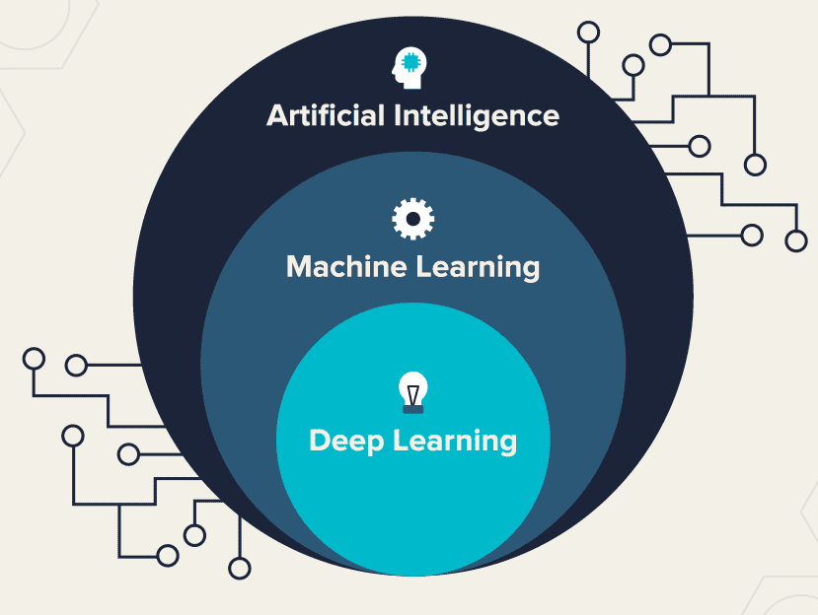
Introduction to Machine Learning
7
ML works through mathematical logic: The relevant characteristics (or "features") of each data point must therefore be expressed numerically, so that the data itself can be fed into a mathematical algorithm that will "learn" to map a given input to the desired output.
Figure-1 : Artificial Intelligence : A wider umbrella

Slide 9
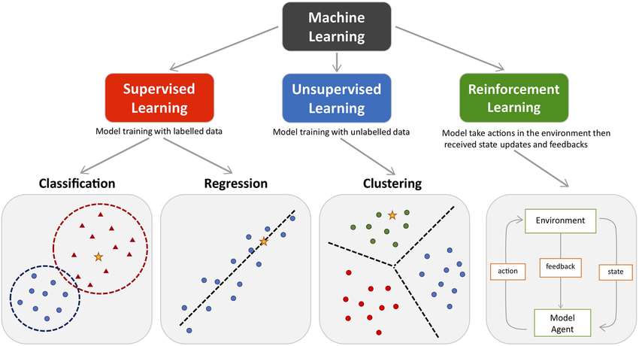
Types of Machine Learning
8
Machine learning can be broadly categorized into three main types, based on how the algorithms learn from data:
Figure-2 : The main types of Machine Learning

Slide 10
Types of Machine Learning
9
Supervised Learning: In supervised learning, the model is trained on labeled data, meaning the input data is paired with the correct output (label). The goal is to learn a mapping from inputs to outputs, allowing the model to predict the label of unseen data.
Example: Predicting house prices based on features like size, location, and number of rooms.
Algorithms: Linear Regression,
Decision Trees,
Support Vector Machines (SVM),
k-Nearest Neighbors (k-NN) etc.

Slide 11
Types of Machine Learning
10
Unsupervised Learning: In unsupervised learning, the model is given input data without any labeled outputs. The model tries to identify patterns or structures in the data, such as clusters or associations.
Example: Grouping customers into segments based on purchasing behavior.
Algorithms: k-Means Clustering,
Hierarchical Clustering,
DBSCAN Clustering,
Association Rule Mining,
Principal Component Analysis (PCA) etc.

Slide 12
Types of Machine Learning
11
Reinforcement Learning: In reinforcement learning, an agent interacts with an environment and learns to take actions that maximize a cumulative reward over time. The model is not explicitly told what actions to take but must explore and exploit the environment to learn.
Example: Training a robot to navigate a maze or teaching a game-playing AI to improve its performance.
Algorithms: Q-learning,
Deep Q Networks (DQN),
Policy Gradient Methods.

Slide 13
Types of Machine Learning
12
Additionally, some other categories are also recognized:
Semi-supervised Learning: Combines elements of both supervised and unsupervised learning, utilizing a small amount of labeled data alongside a large amount of unlabeled data for training.
Self-supervised Learning: A subset of unsupervised learning where the model generates its own labels from the input data, often by predicting missing or corrupted parts of the data.
Generative AI: Focuses on creating new content, such as images, text, or audio, that resembles the data it was trained on. It can be implemented using various techniques, including Generative Adversarial Networks (GANs) and Large Language Models (LLMs).

Slide 14
Regression in Machine Learning
13
Regression is a type of supervised learning algorithm used to predict continuous numerical values based on input features.
Unlike classification, where the goal is to predict discrete labels or categories, regression aims to model the relationship between input variables (independent variables) and a continuous target variable (dependent variable).
Key Concepts of Regression
Continuous Output: In regression problems, the output (also known as the dependent variable) is continuous and can take any value within a range (e.g., predicting house prices, temperatures, sales numbers, etc.).

Slide 15
Regression in Machine Learning
14
Objective: The goal is to find a function that maps the input features to a real-valued output. This function should minimize the difference between the predicted values and the actual values in the training data.
Independent and Dependent Variables: In regression, there are two main types of variable are in use
Independent Variables (also known as features or predictors): The input data that is used to make predictions.
Dependent Variable (also known as the target variable): The output that we are trying to predict.

Slide 16
Types of Regression
15
Linear Regression: Linear regression analysis is used to predict the value of a variable based on the value of another variable. There are two types of Linear Regression:
Simple Linear Regression
Multiple Linear Regression
Polynomial Regression: Polynomial regression is used when the relationship between the independent variable and dependent variable is nonlinear.
Additionally, some other categories are also like
Ridge Regression
Lasso Regression
Elastic Net Regression

Slide 17
Linear Regression
16
Linear regression analysis is used to predict the value of a variable based on the value of another variable. It is a fundamental statistical method used to define linear relationship between a dependent and one or more independent variables.
It helps predict outcomes by fitting a straight line to observed data points, making it easy to interpret and apply.
It is a supervised learning algorithm that is used to model the relationship between a dependent variable and an independent variable.
The algorithm finds the best fit straight-line relationship (linear equation) between the two variables. This statistical method is then used to predict the outcome of future events and is quite useful for predictive analysis.

Slide 18
Linear Regression
17
Linear regression is a statistical technique that estimates the linear relationship between a dependent and one or more independent variables. In machine learning, linear regression is implemented as a supervised learning approach.
In machine learning, labeled datasets contain input data (features) and output labels (target values). For linear regression in machine learning, we represent features as independent variables and target values as the dependent variable.
For the simplicity, take the following data (Single feature and single target)
Square Feet (X) | House Price (Y)
1300 | 240
1500 | 320
1700 | 330
1830 | 295
1550 | 256
2350 | 409
1450 | 319

Slide 19
Linear Regression
18
In the above data, the target House Price is the dependent variable represented by X, and the feature, Square Feet, is the independent variable represented by Y.
The input features (X) are used to predict the target label (Y). So, the independent variables are also known as predictor variables, and the dependent variable is known as the response variable.
So, lets define linear regression in machine learning as follows:
In machine learning, linear regression uses a linear equation to model the relationship between a dependent variable (Y) and one or more independent variables (Y).
The main goal of the linear regression model is to find the best-fitting straight line (often called a regression line) through a set of data points.

Slide 20
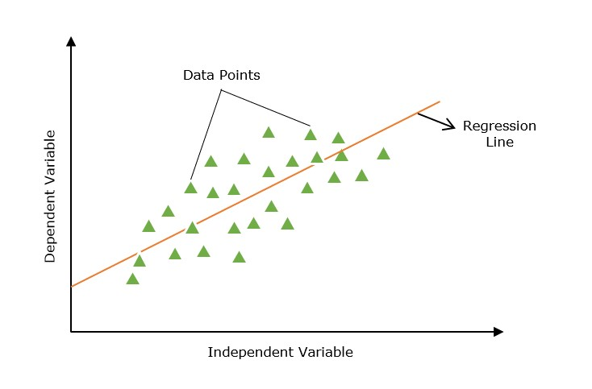
Linear Regression
19
Line of Regression: A straight line that shows a relation between the dependent variable and independent variables is known as the line of regression or regression line.
Figure-3 : Regression Line

Slide 21
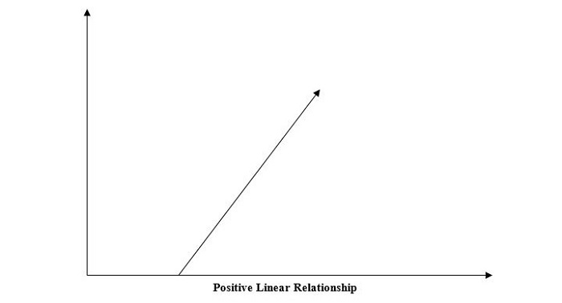
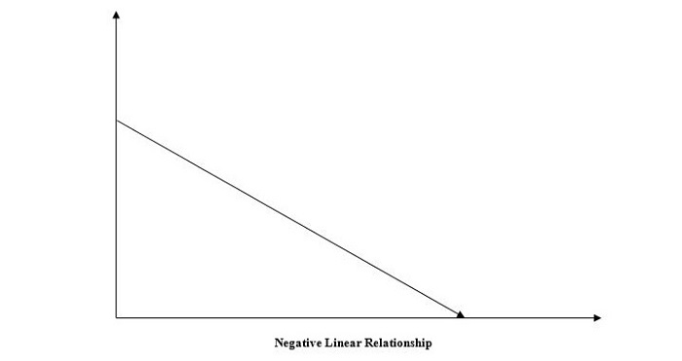
Linear Regression
20
Furthermore, the linear relationship can be positive or negative in nature as explained below
1. Positive Linear Relationship: A linear relationship will be called positive if both independent and dependent variable increases. It can be understood with the help of the figure 4.
2. Negative Linear Relationship: A linear relationship will be called positive if the independent increases and the dependent variable decreases. It can be understood with the help of the figure 5.
Figure-4 : Positive Linear Relationship
Figure-5 : Negative Linear Relationship

Slide 22
Linear Regression
21
Linear regression is of the following two types:
Simple Linear Regression
Multiple Linear Regression
Simple Linear Regression
Simple Linear Regression: It is a type of regression analysis in which a single independent variable (also known as a predictor variable) is used to predict the dependent variable.
In other words, it models the linear relationship between the dependent variable and a single independent variable.

Slide 23
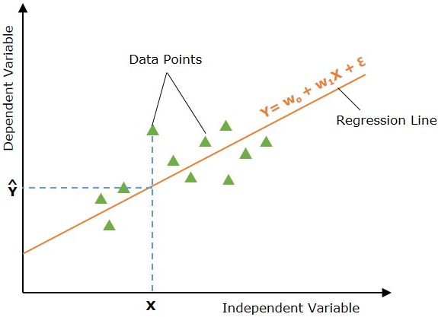
Linear Regression
22
In the below image, the straight line represents the simple linear regression line where Y is the predicted value, and X is the input value.
Mathematically, the relationship can be modeled as a linear equation:
Y = w₀ + w₁X + ϵ
Where: Y is the dependent variable (target).
X is the independent variable (feature).
w₀ is the y-intercept of the line.
w₁ is the slope of the line, representing the effect of X on Y.
ϵ is the error term, capturing the variability in Y not explained by X.
Figure-6 : Simple Linear Regression

Slide 24
Linear Regression
23
Multiple Linear Regression: It is basically the extension of simple linear regression that predicts a response using two or more features.
When dealing with more than one independent variable, we extend simple linear regression to multiple linear regression. The model is expressed as:
Multiple linear regression extends the concept of simple linear regression to multiple independent variables. The model is expressed as:
Where: X₁, X₂, ..., X_{p} are the independent variables (features).
w₀, w₁, ..., w_{p} are the coefficients for these variables.
ϵ is the error term.
Y = w₀ + w₁X₁ +w₂X₂ + ⋯ + w_{p}X_{p} + ϵ

Slide 25
Linear Regression
24
How Does Linear Regression Work?
The main goal of linear regression is to find the best-fit line through a set of data points that minimizes the difference between the actual values and predicted values. So, it is done? This is done by estimating the parameters w₀, w₁ etc.
The working of linear regression in machine learning can be broken down into many steps as follows:
Hypothesis − We assume that there is a linear relation between input and output.
Cost Function − Define a loss or cost function. The cost function quantifies the model's prediction error. The cost function takes the model's predicted values and actual values and returns a single scaler value that represents the cost of the model's prediction.
Optimization − Optimize (minimize) the model's cost function by updating the model's parameters.

Slide 26

Linear Regression
25
It continues updating the model's parameters until the cost or error of the model's prediction is optimized (minimized).
Hypothesis Function For Linear Regression
In linear regression problems, we assume that there is a linear relationship between input features (X) and predicted value (Y).
The hypothesis function returns the predicted value for a given input value. Generally, we represent a hypothesis by h_{w}(X) and it is equal to Y;. Hypothesis function for simple linear regression:
Hypothesis function for multiple linear regression:

Slide 27
Linear Regression
26
For different values of parameters (weights), we can find many regression lines. The main goal is to find the best-fit lines. Let's discuss it as below:
Finding the Best Fit Line
We discussed above that different set of parameters will provide different regression lines.
However, each regression line does not represent the optimal relation between the input and output values. The main goal is to find the best-fit line.
A regression line is said to be the best fit if the error between actual and predicted values is minimal.

Slide 28
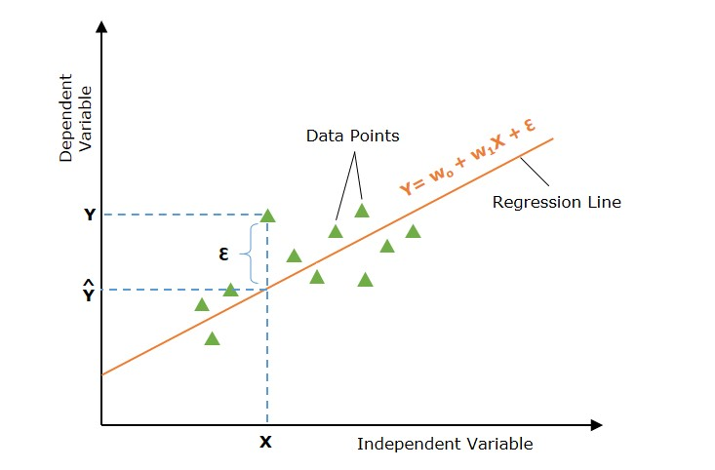
Linear Regression
27
Below image shows a regression line with error (ϵ) at input data point X. The error is calculated for all data points and our goal is to minimize the average error/loss.
We can use different types of loss functions such as mean square error (MSE), mean average error (MAE), L₁ loss, L₂ Loss, etc.
Figure-7 : Regression Line with Error

Slide 29

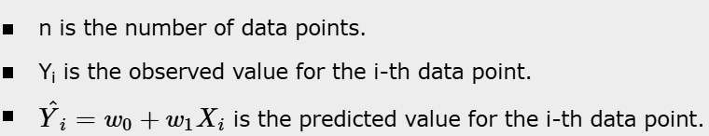
Linear Regression
28
So, how can we minimize the error between the actual and predicted values? Let's discuss the important concept, which is cost function or loss function.
Loss Function for Linear Regression
The error between actual and predicted values can be quantified using a loss function of the cost function. The cost function takes the model's predicted values and actual values and returns a single scaler value that represents the cost of the model's prediction. Our main goal is to minimize the cost function.
The most commonly used cost function is the mean squared error function.

Slide 30
Polynomial Regression
29
Polynomial Linear Regression is a type of regression analysis in which the relationship between the independent variable and the dependent variable is modeled as an n-th degree polynomial function.
Polynomial regression allows for a more complex relationship between the variables to be captured beyond the linear relationship in simple linear regression and multiple linear regression.
In machine learning (ML) and data science, choosing between a linear regression or polynomial regression depends upon the characteristics of the dataset. A non-linear dataset can't be fitted with a linear regression. If we apply linear regression to a nonlinear dataset, it will not be able to capture the non-linear patterns in the data.

Slide 31
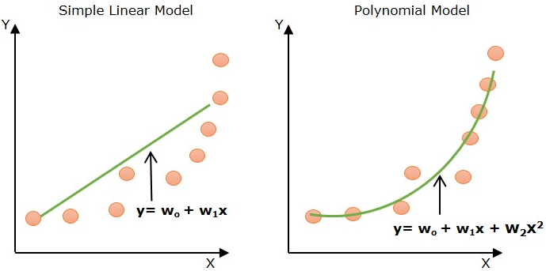
Polynomial Regression
30
Look at the below diagram to understand why we need polynomial regression for non-linear data.
Figure-8 : Need of polynomial regression for non-linear data

Slide 32
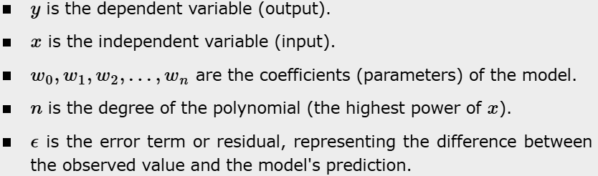
Polynomial Regression
31
The above diagram shows the simple linear model hardly fits the data points whereas the polynomial model fits most of the data points.
Equation of Polynomial Regression Model
In machine learning, the general formula for polynomial regression of degree n is as follows:
Where:

Slide 33
Polynomial Regression
32
How does Polynomial Regression Work?
In machine learning, the polynomial regression actually works in a similar way as linear regression works. It is modeled as multiple linear regression. The input feature is transformed into polynomial features of higher degrees (x²,x³,...,x^{n}).
These features are now treated as separate independent variables as in multiple linear regression. Now, a multiple linear regressor is trained on these transformed features.
The polynomial regression is a special case of multiple linear regression but there is a difference that multiple linear regression assumes linearity of input features. Here, in polynomial regression, the transformed polynomial features are dependent on the original input feature.

Slide 34
Polynomial Regression
33
Need for Polynomial Regression
Non-linear Relationships: Polynomial regression is used when the relationship between the independent variable (input) and dependent variable (output) is non-linear. Unlike linear regression which fits a straight line, it fits a polynomial equation to capture the curve in the data.
Better Fit for Curved Data: When a researcher hypothesizes a curvilinear relationship, polynomial terms are added to the model.
Flexibility and Complexity: It does not assume all independent variables are independent. By introducing higher-degree terms, it allows for more flexibility and can model more complex, curvilinear relationships between variables.

Slide 35
Regression
34
Applications of Regression
1. Predictive Modeling: Linear regression is widely used for predictive modeling. For instance, in real estate, predicting house prices based on features such as size, location, and number of bedrooms can help buyers, sellers, and real estate agents make informed decisions.
2. Feature Selection: In multiple linear regression, analyzing the coefficients can help in feature selection. Features with small or zero coefficients might be considered less important and can be dropped to simplify the model.

Slide 36
Regression
35
3. Financial Forecasting: In finance, linear regression models predict stock prices, economic indicators, and market trends. Accurate forecasts can guide investment strategies and financial planning.
4. Risk Management: Linear regression helps in risk assessment by modeling the relationship between risk factors and financial metrics. For example, in insurance, it can model the relationship between policyholder characteristics and claim amounts.
Advantages of Regression
Interpretability − Linear regression is easy to understand, which is useful when explaining how a model makes decisions.

Slide 37
Regression
36
Speed − Linear regression is faster to train than many other machine learning algorithms.
Predictive analytics − Linear regression is a fundamental building block for predictive analytics.
Linear relationships − Linear regression is a powerful statistical method for finding linear relationships between variables.
Simplicity − Linear regression is simple to implement and interpret.
Efficiency − Linear regression is efficient to compute.

Slide 38
Regression
37
Common Challenges with Linear Regression
1. Overfitting
Overfitting occurs when the regression model performs well on training data but lacks generalization on test data. Overfitting leads to poor prediction on new, unseen data.
2. Multicollinearity
When the dependent variables (predictor or feature variables) correlate, the situation is known as multicollinearity. In this, the estimates of the parameters (coefficients) can be unstable.
3. Outliers and Their Impact
Outliers can cause the regression line to be a poor fit for the majority of data points.

Slide 39
Applications of the Topic
38
Here are applications of Regression (all types: linear, polynomial, regularized, etc.):
• Business & Finance
• Healthcare & Medicine
• Real Estate & Economics
• Engineering & Physical Sciences
• Computer Science & Machine Learning
• Marketing & Customer Analytics
• Environment & Agriculture
• Control Systems & Robotics

Slide 40
Summary of the Lecture
39
Regression in machine learning is a supervised learning technique used to predict continuous numerical values by modeling the relationship between input features and an output variable.
It includes methods like linear regression for straight-line relationships and polynomial regression for curved patterns, along with regularized forms such as ridge and lasso to reduce overfitting.
Regression helps in forecasting, trend analysis, and real-world predictions such as house prices, sales, temperature, and medical indicators. The performance of regression models is evaluated using metrics like MAE, MSE, RMSE, and R², which measure how accurately the model predicts outcomes.

Slide 41
Next Lecture
40
In next lecture, we are going to cover:
Maxima and Minima of Function of One Variable
Rank, Eigen Values and Eigen Vectors
Positive & Negative Definite/Semi-Definite Matrices

Slide 42
Quiz/ FAQ’s
41
Define regression in one line.
Name any two-evaluation metrics used in regression.
Write the general equation of simple linear regression.
What is the difference between classification and regression?
Give one real-world application of linear regression.
Which metric is commonly used to measure how much variance in the target is explained by the model?
Regression is mainly used for which type of applications.

Slide 43
References/ Articles/ Videos
42
Text/ Reference Books
T1 | Massaron, L., & Boschetti, A. (2016). Regression analysis with Python. Packt Publishing Ltd.
T2 | Jajuga, K., Sokolowski, A., & Bock, H. H. (Eds.). (2012). Classification, clustering, and data analysis: recent advances and applications.
T3 | Bishop, C. M., & Bishop, H. (2023). Deep learning: Foundations and concepts. Springer Nature.
R1 | Matloff, N. (2017). Statistical regression and classification: from linear models to machine learning. Chapman and Hall/CRC.
R2 | Jajuga, K., Sokolowski, A., & Bock, H. H. (Eds.). (2012). Classification, clustering, and data analysis: recent advances and applications.
R3 | Vishnoi, V. K., Chauhan, N. R., & Kumar, K. (2024). An introduction to deep learning. Xoffencerpublication.

Slide 44
Faculty-curated videos, NPTEL, Coursera, LinkedIn, or other relevant learning resources
43
https://www.coursera.org/learn/ismdl?source=admin-share
https://www.coursera.org/learn/ismdl?source=admin-share
https://www.coursera.org/learn/ai-for-real-world-intelligence-systems?source=admin-share
https://www.coursera.org/learn/ai-for-real-world-intelligence-systems?source=admin-share
https://www.coursera.org/learn/deep-learning-applications-in-vision?source=admin-share
https://www.coursera.org/learn/deep-learning-applications-in-vision?source=admin-share
https://www.coursera.org/learn/ismdl?source=admin-share

Slide 45

44
Class-Wise Feedback
Note: Scan this QR code to provide anonymous feedback.

Slide 46
45
Thank You
For queries
Email: siddharth.e12853@cumail.in

